Slide 1

Burnout Issues in Employees
Mohammed Khaja Rahmat Ullah

Slide 2

PROBLEM STATEMENT
This project helps us to understand the problem of burnout analysis and predictions based on employees of Product and Service based companies

Slide 3
Project Description By creating certain codes, we can deduct, predict and analyse future based on employees information

Slide 4

WHO ARE THE END USERS?
The end users for the burnout and predictions can be different organisations, ranging from a startup to even W.H.O

Slide 5

Technology Used
We’ve used several libraries in this project such as:
Pandas
Numpy
Pyplot
Sklearn : AdaBoost Regressor, RandomForest Regressor, PCA, Decomposition

Slide 6
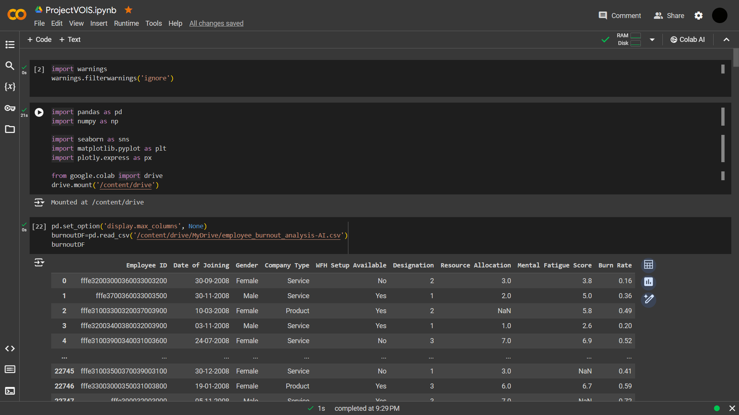
RESULTS
[Add screen shots of your code ]
Demo Link

Slide 7
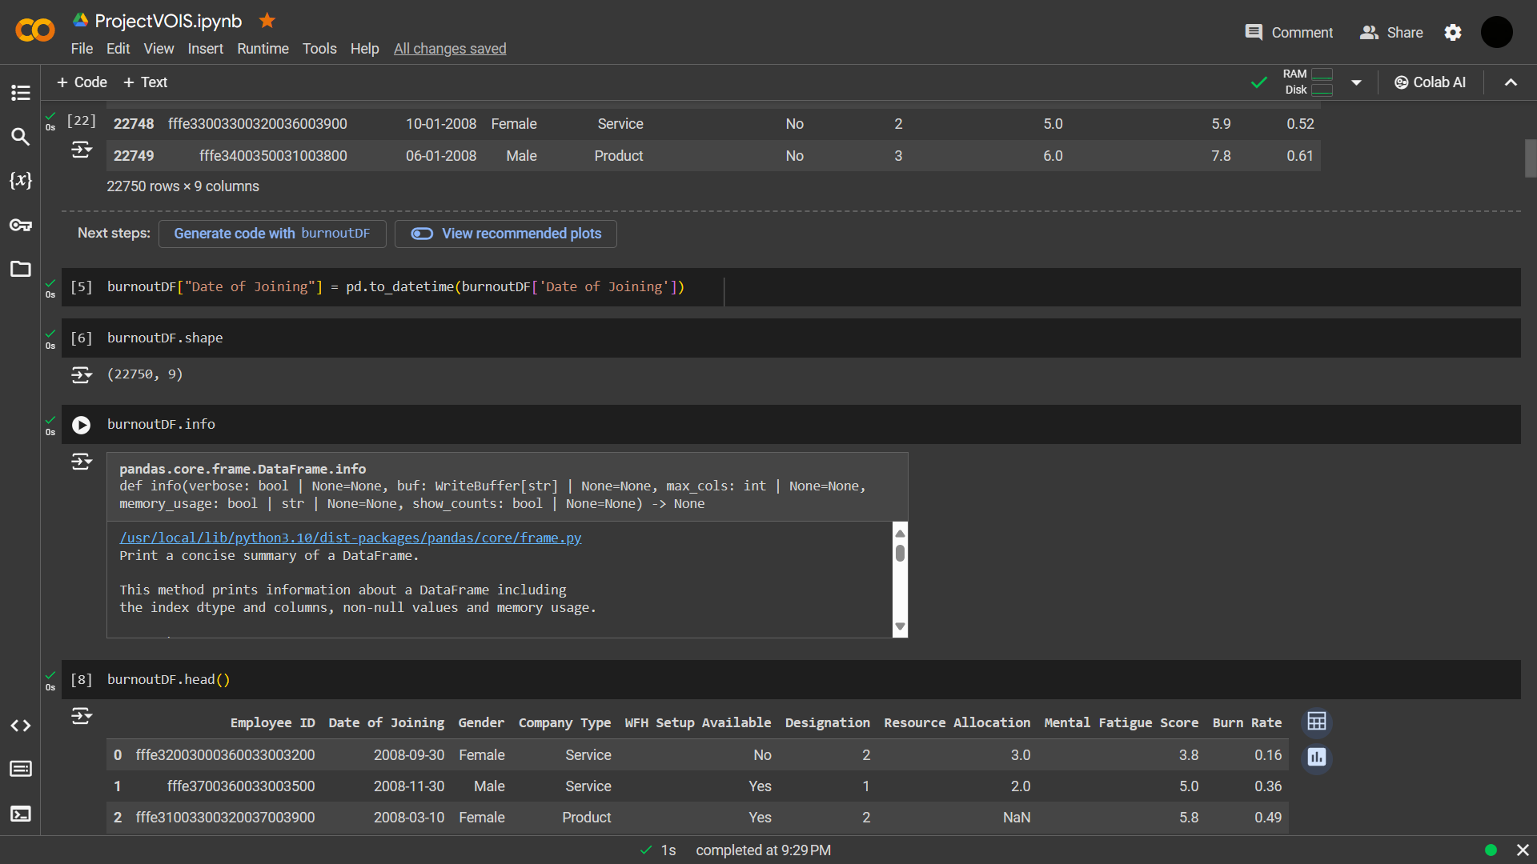
RESULTS
[Add screen shots of your code ]
Demo Link

Slide 8
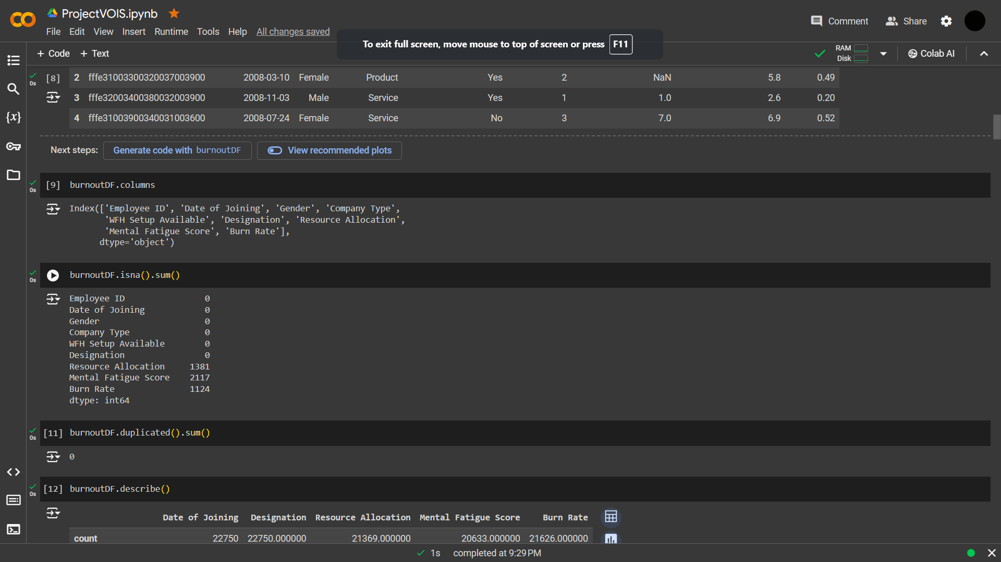
RESULTS
[Add screen shots of your code ]
Demo Link

Slide 9
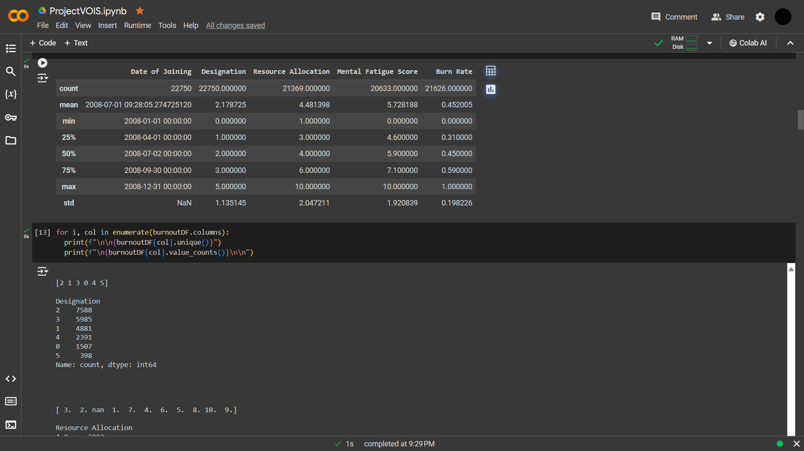
RESULTS
[Add screen shots of your code ]
Demo Link

Slide 10
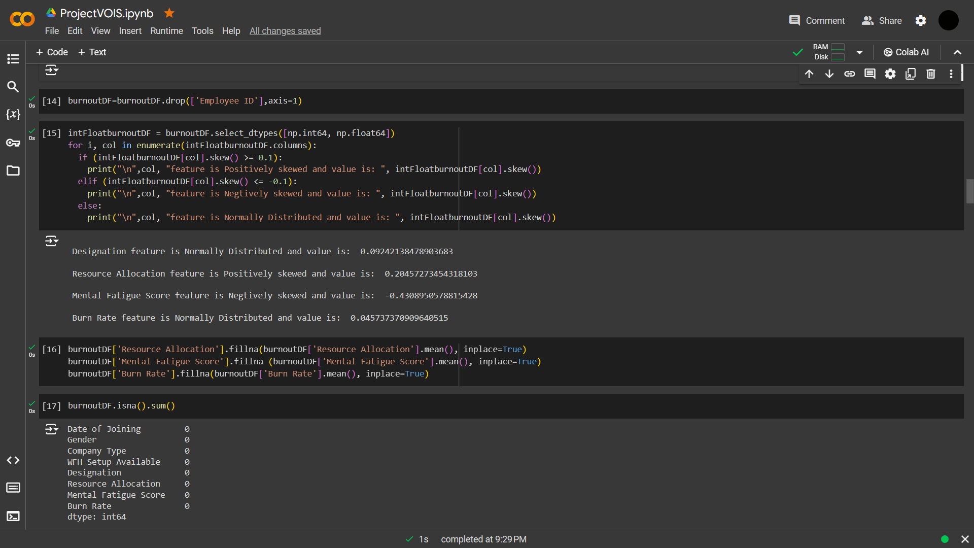
RESULTS
[Add screen shots of your code ]
Demo Link

Slide 11
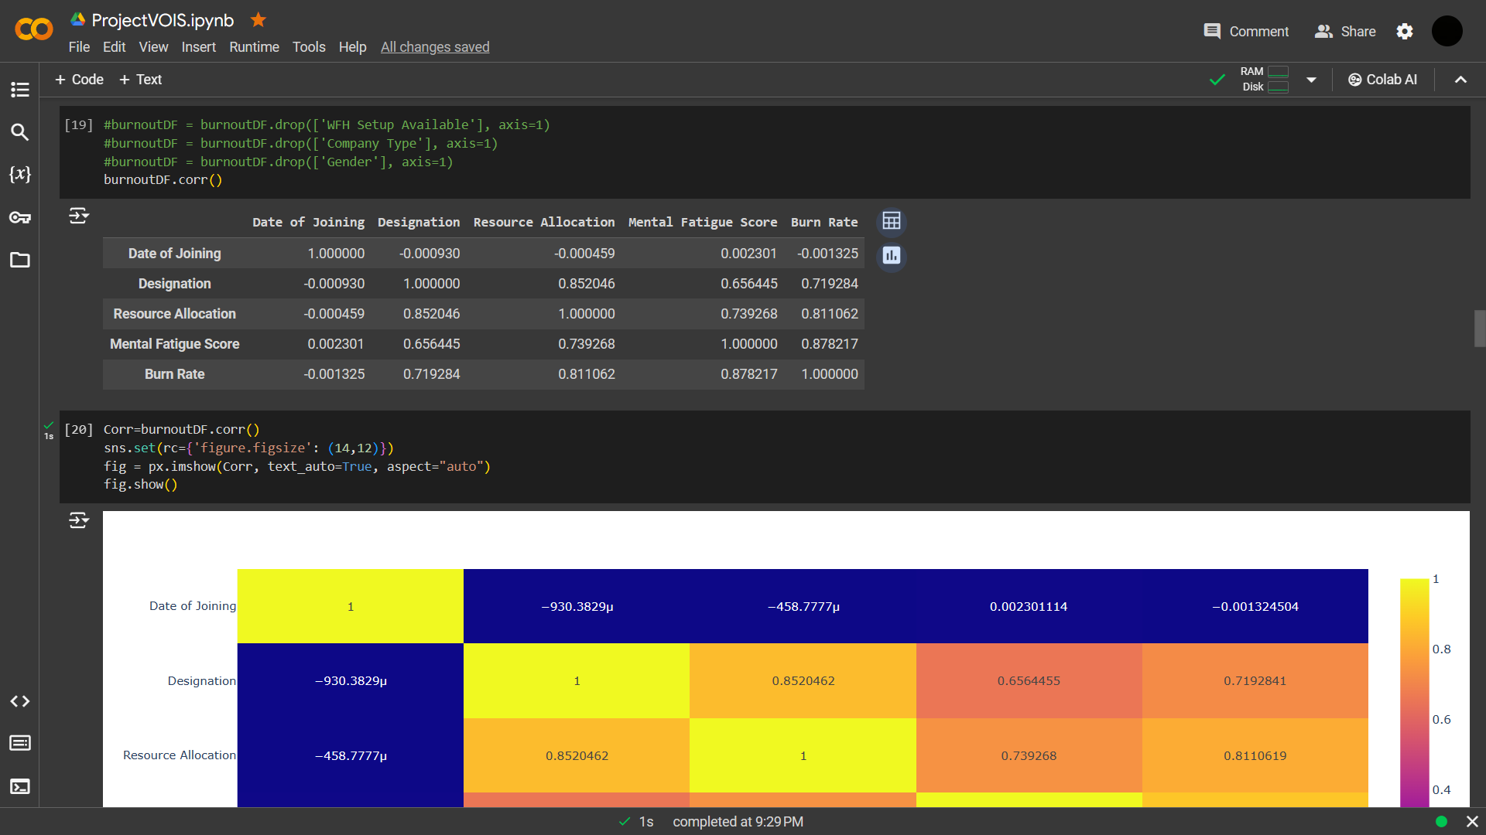
RESULTS
[Add screen shots of your code ]
Demo Link

Slide 12
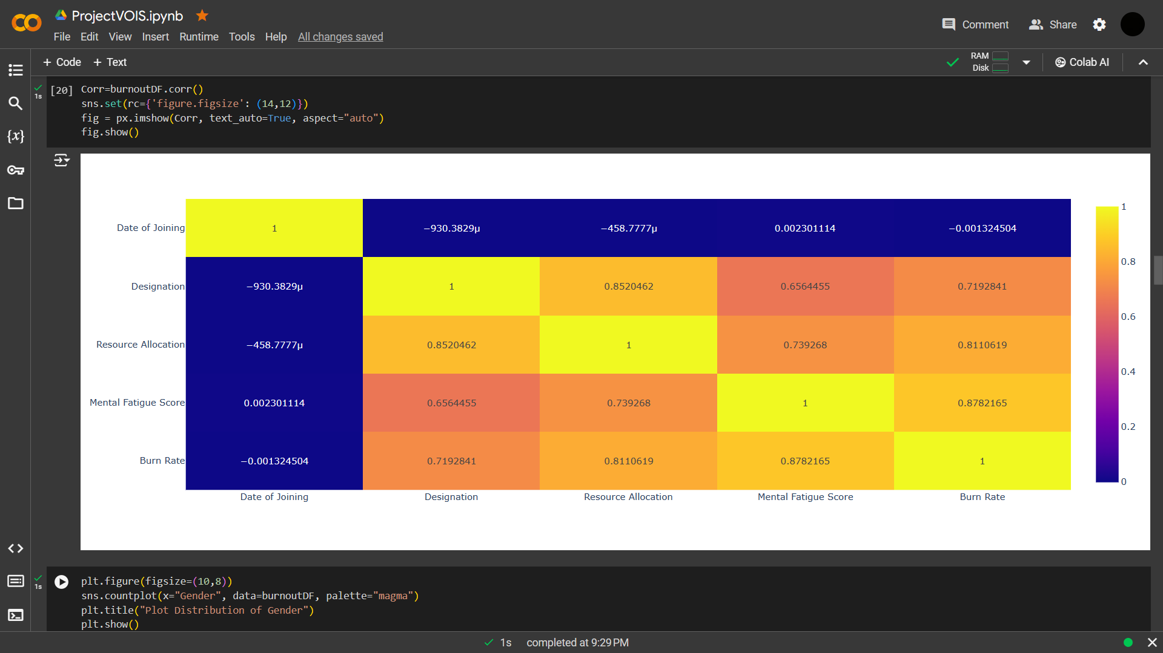
RESULTS
[Add screen shots of your code ]
Demo Link

Slide 13
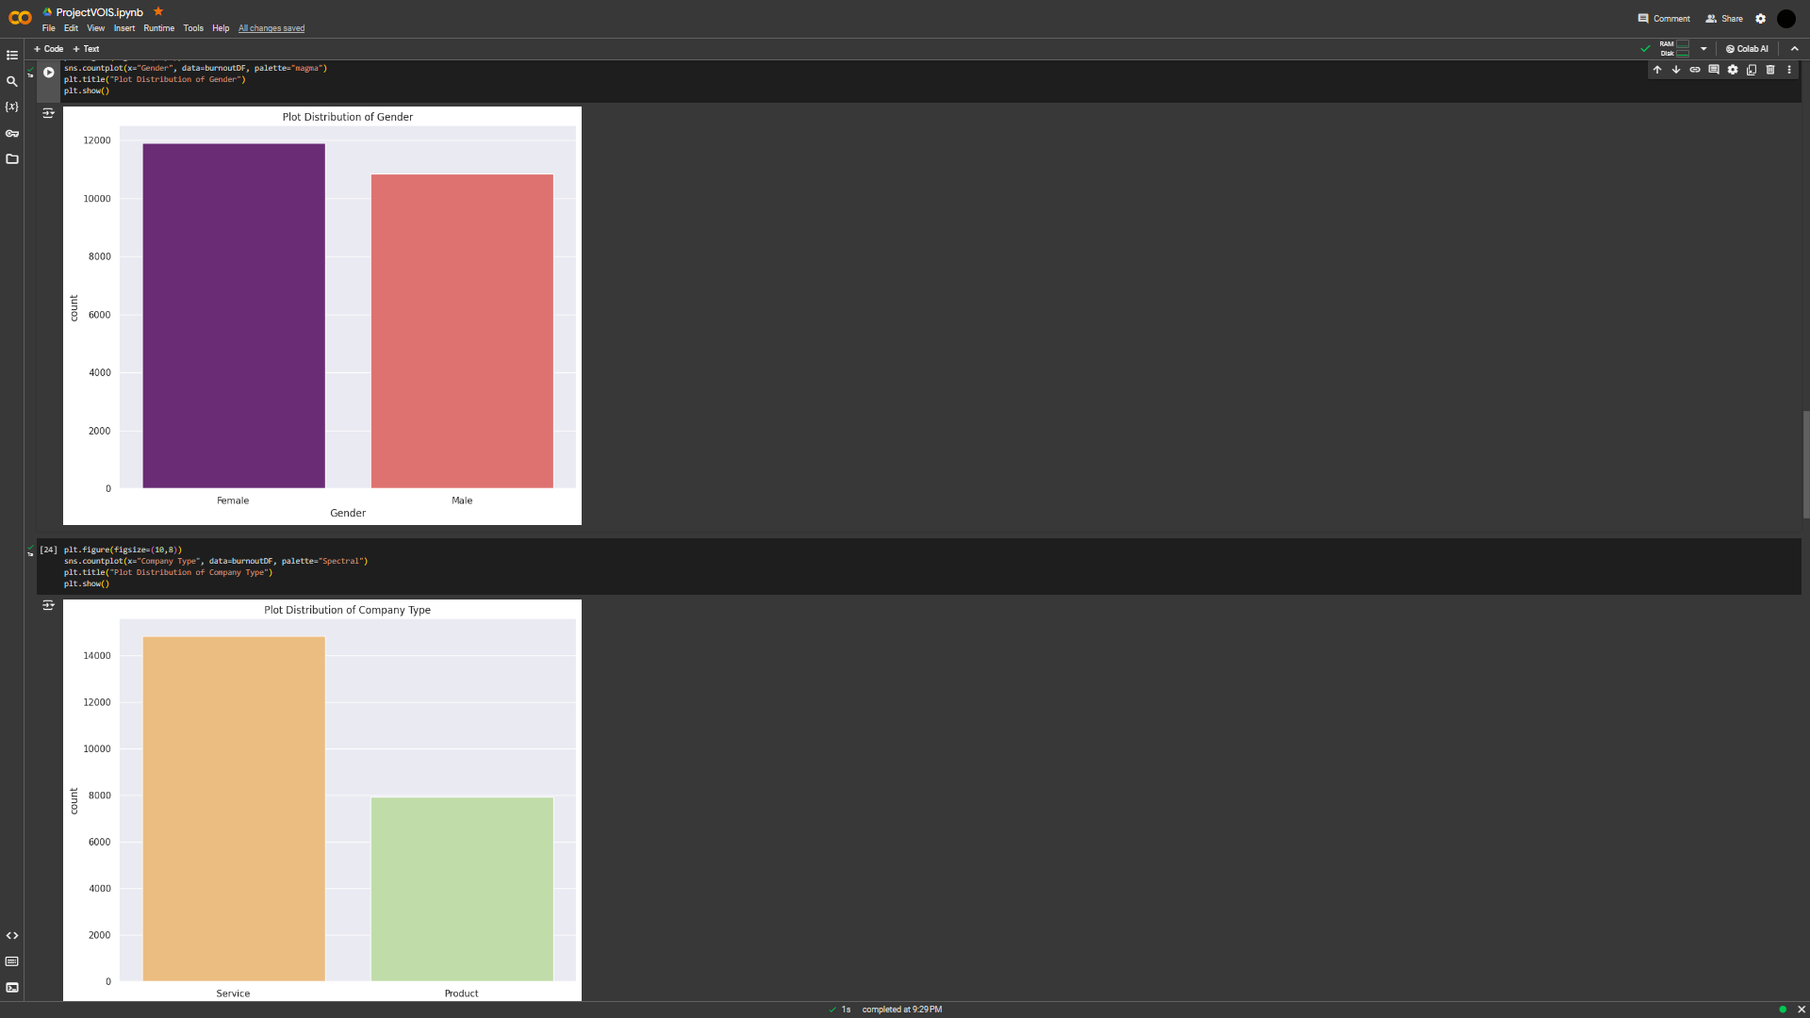
RESULTS
[Add screen shots of your code ]
Demo Link

Slide 14
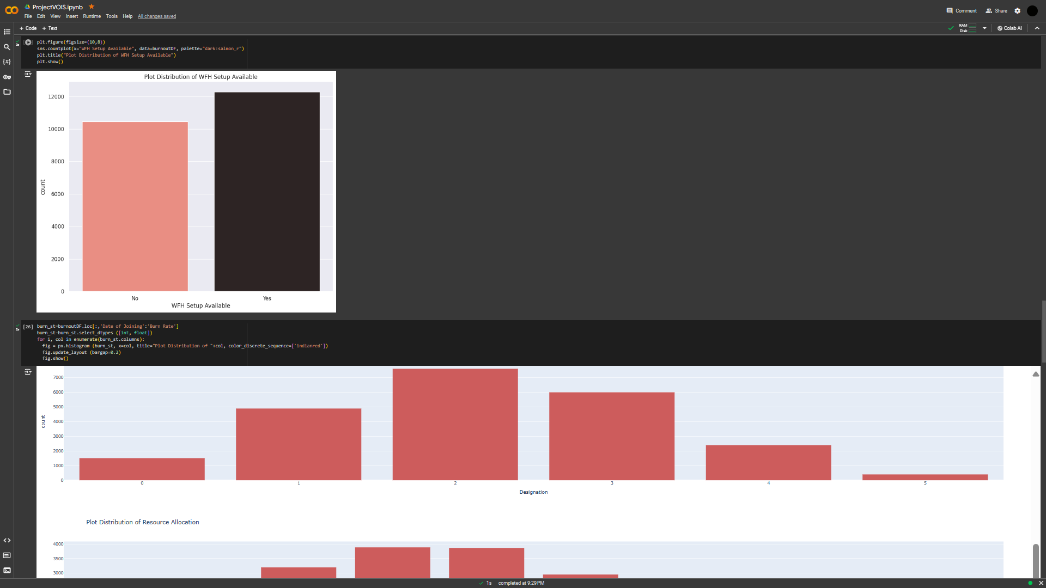
RESULTS
[Add screen shots of your code ]
Demo Link

Slide 15
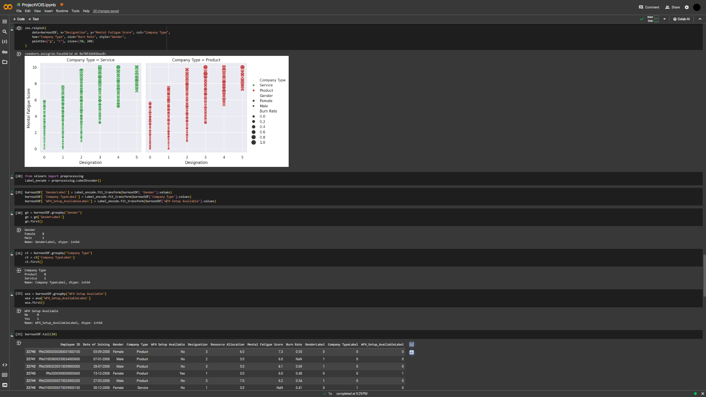
RESULTS
[Add screen shots of your code ]
Demo Link

Slide 16
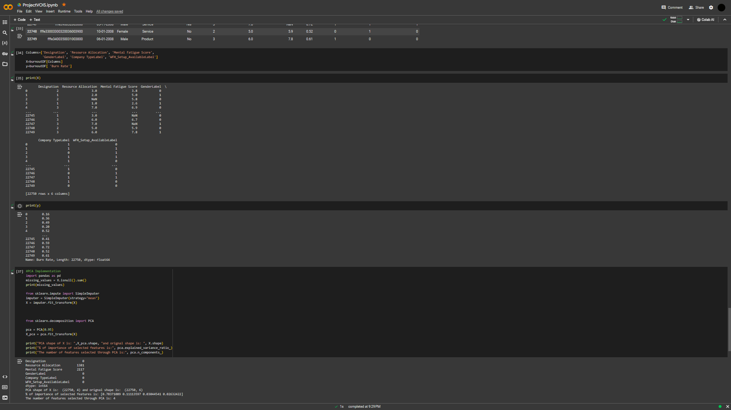
RESULTS
[Add screen shots of your code ]
Demo Link

Slide 17
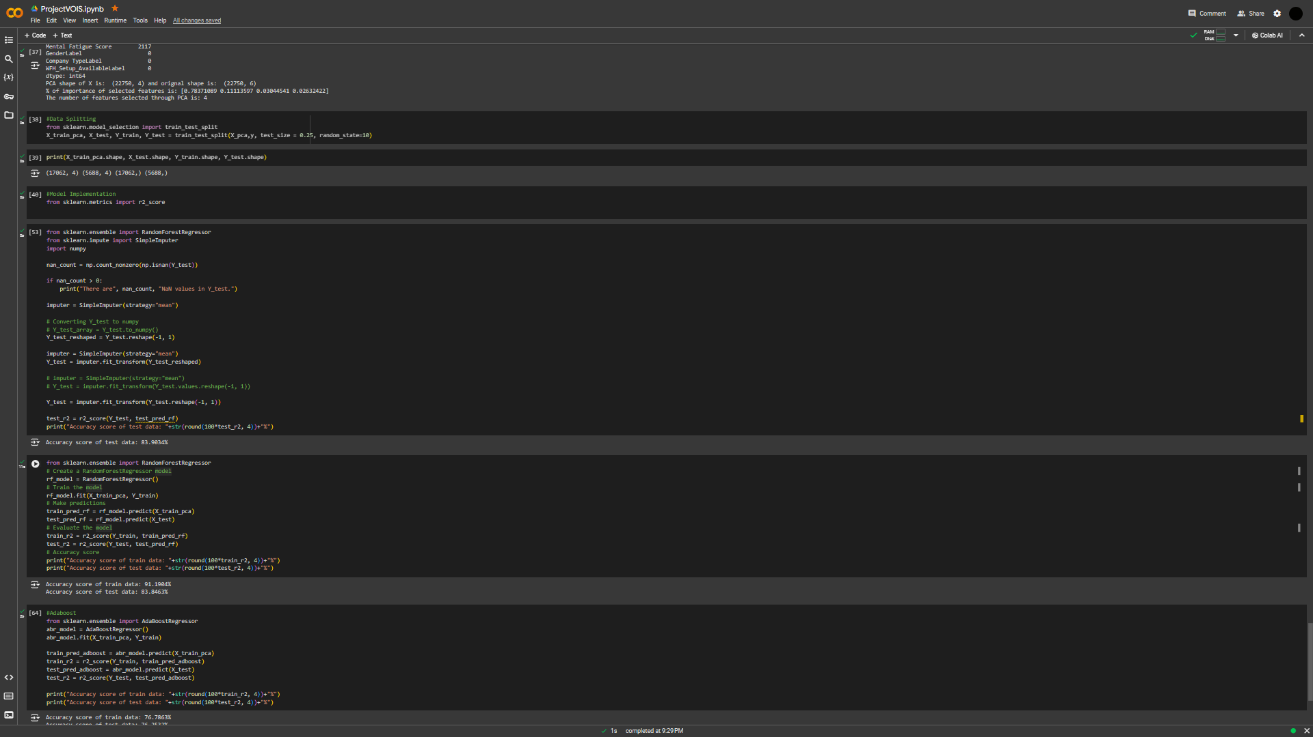
RESULTS
[Add screen shots of your code ]
Demo Link

Slide 18
Thank you
.
.

